Slide 1
AP Exam – Lab Topics Review
Things to know about labs, measurements and data analysis.

Slide 2
Beer – Lambert Law
Colored solutions (involving transition metals)
A = abc
A = absorbance, the darker the color, the more absorbance, the greater the concentration
a = molar absorbtivity
b = path length (width of the cuvette)
c = concentration
Absorbance and Concentration are directly related.
Optimum wavelength to use in a colorimeter or spectrophometer is that of the complementary color to the color of the solution (i.e., the color that gives the highest absorbance)
Dilutions and Glassware (buret, pipet, volumetric flask, safety)

Slide 3
Ion Concentration in Solution
Solution Stoichiometry
Solubility rules (alkali, ammonium, acetate, nitrate and chlorates are always spectator ions)
Net ionic equations – how and why
Drawing Particle Diagrams
Gravimetric Analysis - Weighing
Pay attention to limiting and excess reagents
Watch for stoichiometry
Rinse precipitate with water several times
Measure to complete dryness
Loss of Mass & Affects on Data
Solubility and Intermolecular forces
Ionic salts will tend to dissolve in polar solvents such as water. Ion-Dipole forces

Slide 4
Reaction Calculations

Slide 5
Heat of Solution
Enthalpy of reaction and calorimetry
The application of q = m c ∆T
A procedure for calorimetry /experimental design
Heat loss / sample loss and their effects on calculations
The energy changes associated with dissolving an ionic solid (endo/exo)
Glassware

Slide 6
Heat of Solution – Practice 2016 – #1ai & aii
A student investigates the enthalpy of solution, ΔH_{soln} , for two alkali metal halides, LiCl and NaCl. In addition to the salts, the student has access to a calorimeter, a balance with a precision of ±0.1 g, and a thermometer with a precision of ±0.1°C.
(a) To measure ΔH_{soln} for LiCl, the student adds 100.0 g of water initially at 15.0°C to a calorimeter and adds 10.0 g of LiCl(s), stirring to dissolve. After the LiCl dissolves completely, the maximum temperature reached by the solution is 35.6°C.
(i) Calculate the magnitude of the heat absorbed by the solution during the dissolution process, assuming that the specific heat capacity of the solution is 4.18 J/(g·°C). Include units with your answer.
(ii) Determine the value of ΔH_{soln} for LiCl in kJ/mol_{rxn}. To explain why ΔH_{soln} for NaCl is different than that for LiCl, the student investigates factors that affect ΔH_{soln} and finds that ionic radius and lattice enthalpy (which can be defined as the ΔH associated with the separation of a solid crystal into gaseous ions) contribute to the process. The student consults references and collects the data shown in the table below.

Slide 7
Heat of Solution – Practice 2016 - #1b-d
Ion | Ionic Radius (pm)
Li⁺ | 76
Na⁺ | 102
To explain why ΔH_{soln} for NaCl is different than that for LiCl, the student investigates factors that affect ΔH_{soln} and finds that ionic radius and lattice enthalpy (which can be defined as the ΔH associated with the separation of a solid crystal into gaseous ions) contribute to the process. The student consults references and collects the data shown in the table above.
(b) Write the complete electron configuration for the Na+ ion in the ground state.
(c) Using principles of atomic structure, explain why the Na⁺ ion is larger than the Li⁺ ion.
(d) Which salt, LiCl or NaCl, has the greater lattice enthalpy? Justify your answer.

Slide 8
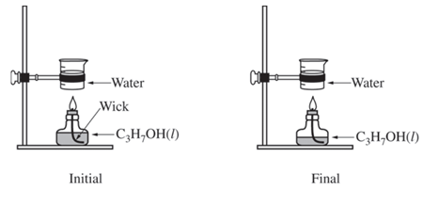
Thermodynamics – Practice 2017 #5a
2 C₃H₇OH(l) + 9 O₂(g) → 6 CO₂(g) + 8 H₂O(g)
A student performs an experiment to determine the enthalpy of combustion of 2-propanol, C₃H₇OH(l), which combusts in oxygen according to the equation above. The student heats a sample of water by burning some of the C₃H₇OH(l) that is in an alcohol burner, as represented below. The alcohol burner uses a wick to draw liquid up into the flame. The mass of C₃H₇OH(l) combusted is determined by weighing the alcohol burner before and after combustion. Data from the experiment are given in the table to the right.
(a) Calculate the magnitude of the heat energy, in kJ, absorbed by the water. (Assume that the energy released from the combustion is completely transferred to the water.)
Mass of C₃H₇OH(l) combusted | 0.55 g
Mass of water heated | 125.00 g
Initial temperature of water | 22.0°C
Final temperature of water | 51.1°C
Specific heat of water 4.18 J/(g·°C)

Slide 9
Thermodynamics – Practice 2017 #5b & c
(b) Based on the experimental data, if one mole of C₃H₇OH(l) is combusted, how much heat, in kJ, is released? Report your answer with the correct number of significant figures.
(c) A second student performs the experiment using the same mass of water at the same initial temperature. However, the student uses an alcohol burner containing C₃H₇OH(l) that is contaminated with water, which is miscible with C₃H₇OH(l). The difference in mass of the alcohol burner before and after the combustion in this experiment is also 0.55 g. Would the final temperature of the water in the beaker heated by the alcohol burner in this experiment be greater than, less than, or equal to the final temperature of the water in the beaker in the first student’s experiment? Justify your answer.

Slide 10
Acid-Base Titrations
Neutralization reactions, i.e., acid + base → salt + water
Titration procedure including washing and filling burets and pipets, selection of indicators
Standardizing a solution
Titration Curves (EQ pt, ½ EQ pt, buffer region)
End-Point vs Equivalence Point
Buffering Capacity
Polyprotic acid

Slide 11
Acid-Base Practice 2016 - #2a-c
NaHCO₃(s) + HC₂H₃O₂(aq) → NaC₂H₃O₂(aq) + H₂O(l) + CO₂(g)
A student designs an experiment to study the reaction between NaHCO₃ and HC₂H₃O₂ . The reaction is represented by the equation above. The student places 2.24 g of NaHCO₃ in a flask and adds 60.0 mL of 0.875 M HC₂H₃O₂ . The student observes the formation of bubbles and that the flask gets cooler as the reaction proceeds.
(a) Identify the reaction represented above as an acid-base reaction, precipitation reaction, or redox reaction. Justify your answer.
(b) Based on the information above, identify the limiting reactant. Justify your answer with calculations.
(c) The student observes that the bubbling is rapid at the beginning of the reaction and gradually slows as the reaction continues. Explain this change in the reaction rate in terms of the collisions between reactant particles.

Slide 12
Acid-Base Practice 2017 #3ci & ii
Nitrogen monoxide, NO(g), can undergo further reactions to produce acids such as HNO₂, a weak acid with a K_{a} of 4.0 × 10⁻⁴ and a pK_{a} of 3.40. A student is asked to make a buffer solution with a pH of 3.40 by using 0.100 M HNO₂(aq) and 0.100 M NaOH(aq).
(i) Explain why the addition of 0.100 M NaOH(aq) to 0.100 M HNO₂(aq) can result in the formation of a buffer solution. Include the net ionic equation for the reaction that occurs when the student adds the NaOH(aq) to the HNO₂(aq).
(ii) Determine the volume, in mL, of 0.100 M NaOH(aq) the student should add to 100. mL of 0.100 M HNO2(aq) to make a buffer solution with a pH of 3.40. Justify your answer.

Slide 13
Acid-Base Practice 2017 #3d
(d) A second student makes a buffer by dissolving 0.100 mol of NaNO2(s) in 100. mL of 1.00 M HNO2(aq). Which is more resistant to changes in pH when a strong acid or a strong base is added, the buffer made by the second student or the buffer made by the first student in part (c) ? Justify your answer.

Slide 14
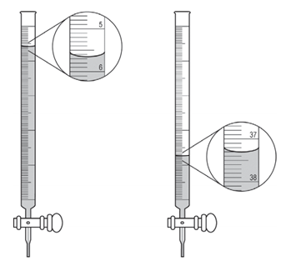
Acid-Base Practice 2016 #7a
A student is given a 25.0 mL sample of a solution of an unknown monoprotic acid and asked to determine the concentration of the acid by titration. The student uses a standardized solution of 0.110 M NaOH(aq), a buret, a flask, an appropriate indicator, and other laboratory equipment necessary for the titration.
(a) The images to the right show the buret before the titration begins (below left) and at the end point (below right). What should the student record as the volume of NaOH(aq) delivered to the flask?

Slide 15
Acid-Base Practice 2016 #7b-c
(b) Based on the given information and your answer to part (a), determine the value of the concentration of the acid that should be recorded in the student’s lab report.
(c) In a second trial, the student accidentally added more NaOH(aq) to the flask than was needed to reach the end point, and then recorded the final volume. Would this error increase, decrease, or have no effect on the calculated acid concentration for the second trial? Justify your answer.

Slide 16
Chromatography
That chromatography involves a mobile phase and a stationary phase and that separation depends on the components affinity for one or the other
How to calculate an Rf value
Travels far – strong affinity for the solvent phase
Doesn’t travel far – strong affinity for the stationary phase
Procedure for a simple chromatography experiment.
Choosing an appropriate solvent based on polarities

Slide 17
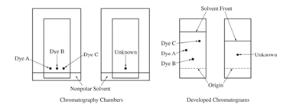
Chromatography – Practice 2017 #4
A student investigates various dyes using paper chromatography. The student has samples of three pure dyes, labeled A, B, and C, and an unknown sample that contains one of the three dyes. The student prepares the chromatography chambers shown above on the left by putting a drop of each dye at the indicated position on the chromatography paper (a polar material) and standing the paper in a nonpolar solvent. The developed chromatograms are shown above on the right.
(a) Which dye (A, B, or C) is the least polar? Justify your answer in terms of the interactions between the dyes and the solvent or between the dyes and the paper.
(b) Which dye is present in the unknown sample? Justify your answer.

Slide 18
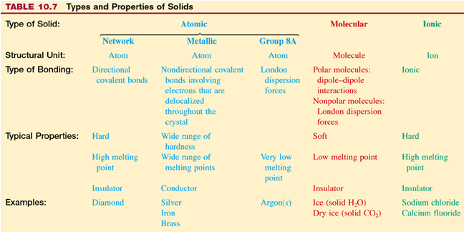
Bonding & Properties

Slide 19
Bonding and Solutions – Practice 2016 - #3
M + I₂ → MI₂
To determine the molar mass of an unknown metal, M, a student reacts iodine with an excess of the metal to form the water-soluble compound MI₂, as represented by the equation above. The reaction proceeds until all of the I₂ is consumed. The MI₂(aq) solution is quantitatively collected and heated to remove the water, and the product is dried and weighed to constant mass. The experimental steps are represented to the right, followed by a data table.

Slide 20
Bonding and Solutions – Practice 2016 - #3a-c
(a) Given that the metal M is in excess, calculate the number of moles of I₂ that reacted.
(b) Calculate the molar mass of the unknown metal M.
The student hypothesizes that the compound formed in the synthesis reaction is ionic.
(c) Propose an experimental test the student could perform that could be used to support the hypothesis. Explain how the results of the test would support the hypothesis if the substance was ionic.

Slide 21
Bonding and Solutions – Practice 2016 - #3d
The student hypothesizes that Br₂ will react with metal M more vigorously than I₂ did because Br₂ is a liquid at room temperature.
(d) Explain why I₂ is a solid at room temperature whereas Br₂ is a liquid. Your explanation should clearly reference the types and relative strengths of the intermolecular forces present in each substance.

Slide 22
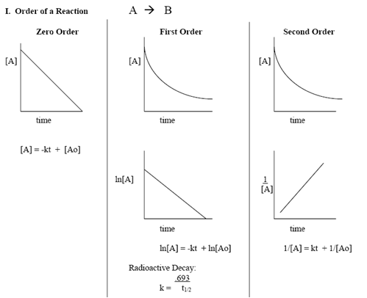
Kinetics
Particle size, concentration and temperature affect the speed of a chemical reaction
Design an experiment with controls, to investigate the speed of a chemical reaction (including how to measure the rate of reaction)
To interpret data that is generated in such an experiment including graphical representations
Using initial rate and concentration data to determine a reaction rate law
The relationship between changes of rate and orders of reaction
The shape and interpretation of graphs as they relate to zeroth, first and second order reactions

Slide 23
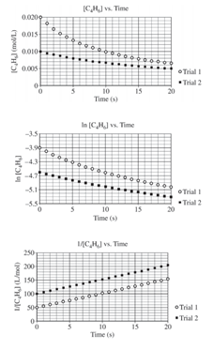
Kinetics – Practice 2016 – #5 data
2 C₄H₆(g) → C₈H₁₂(g)
At high temperatures the compound C₄H₆ (1,3-butadiene) reacts according to the equation above. The rate of the reaction was studied at 625 K in a rigid reaction vessel. Two different trials, each with a different starting concentration, were carried out. The data were plotted in three different ways, as shown to the right.

Slide 24
Kinetics – Practice 2016 – #5a-c
(a) For trial 1, calculate the initial pressure, in atm, in the vessel at 625 K. Assume that initially all the gas present in the vessel is C₄H₆.
(b) Use the data plotted in the graphs to determine the order of the reaction with respect to C₄H₆.
(c) The initial rate of the reaction in trial 1 is 0.0010 mol/(L⋅s). Calculate the rate constant, k, for the reaction at 625 K.

Slide 25
Redox Titration
Definition, oxidation number, OIL RIG
Balancing including ½ reactions
Titration Procedure
Stoichiometry
Color change and why

Slide 26
Le Chatelier’s Principle
Explain WHY reactions shift
Pressure & Volume
Catalyst
Add or Remove a substance
Temperature
Q vs. K
Writing Mass Action Expressions
ICE tables

